Slide 1
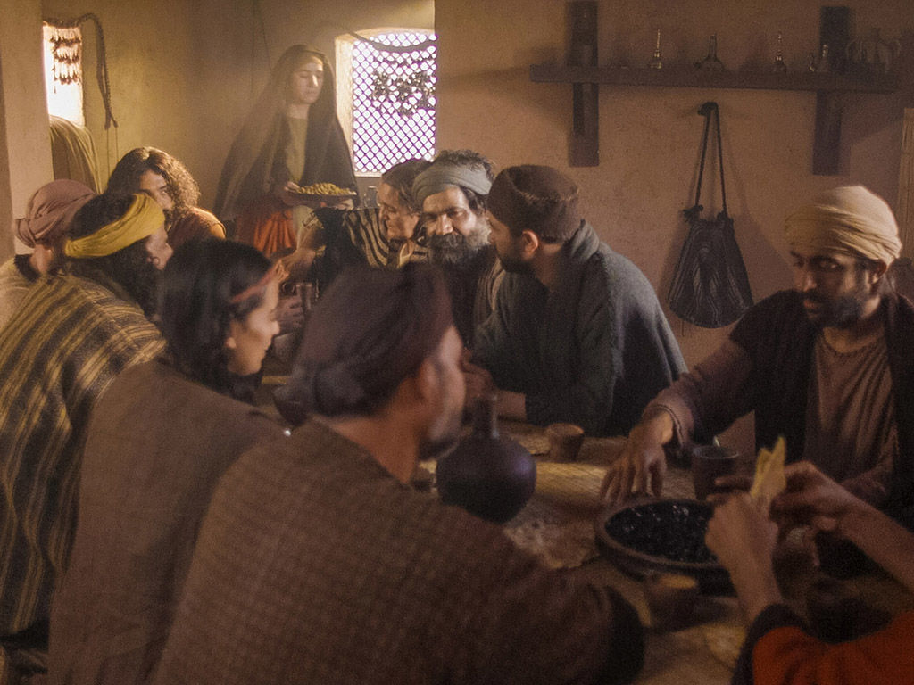
An unforgettable meal
John 12:1-11

Slide 2
An unforgettable meal
John 12:1-11
Dinner party

Slide 3
An unforgettable meal
John 12:1-11
Dinner party
Background buzz (John 11:55-57)

Slide 4
An unforgettable meal
John 12:1-11
Dinner party
Background buzz (John 11:55-57)
Rising tension (Mark 14:1-2)

Slide 5
An unforgettable meal
John 12:1-11
Dinner party
Background buzz (John 11:55-57)
Rising tension (Mark 14:1-2)
The meal itself (12:1-2)

Slide 6
An unforgettable meal
John 12:1-11
Dinner party
Background buzz (John 11:55-57)
Rising tension (Mark 14:1-2)
The meal itself (12:1-2)
Mary’s action (12:3)

Slide 7
An unforgettable meal
John 12:1-11
Dinner party
Background buzz (John 11:55-57)
Rising tension (Mark 14:1-2)
The meal itself (12:1-2)
Mary’s action (12:3)
Different reactions (12:4-8)

Slide 8
An unforgettable meal
John 12:1-11
Dinner party
Background buzz (John 11:55-57)
Rising tension (Mark 14:1-2)
The meal itself (12:1-2)
Mary’s action (12:3)
Different reactions (12:4-8)
Negative

Slide 9
An unforgettable meal
John 12:1-11
Dinner party
Background buzz (John 11:55-57)
Rising tension (Mark 14:1-2)
The meal itself (12:1-2)
Mary’s action (12:3)
Different reactions (12:4-8)
Negative
Positive

Slide 10
An unforgettable meal
John 12:1-11
Dinner party
Background buzz (John 11:55-57)
Rising tension (Mark 14:1-2)
The meal itself (12:1-2)
Mary’s action (12:3)
Different reactions (12:4-8)
The outcome (12:9-11)

Slide 11
An unforgettable meal
John 12:1-11
Dinner party
Background buzz (John 11:55-57)
Rising tension (Mark 14:1-2)
The meal itself (12:1-2)
Mary’s action (12:3)
Different reactions (12:4-8)
The outcome (12:9-11)
Practical lessons

Slide 12
An unforgettable meal
John 12:1-11
Dinner party
Background buzz (John 11:55-57)
Rising tension (Mark 14:1-2)
The meal itself (12:1-2)
Mary’s action (12:3)
Different reactions (12:4-8)
The outcome (12:9-11)
Practical lessons
God loves extravagant expressions of devotion

Slide 13
An unforgettable meal
John 12:1-11
Dinner party
Background buzz (John 11:55-57)
Rising tension (Mark 14:1-2)
The meal itself (12:1-2)
Mary’s action (12:3)
Different reactions (12:4-8)
The outcome (12:9-11)
Practical lessons
God loves extravagant expressions of devotion
Attention! Danger !

Slide 14
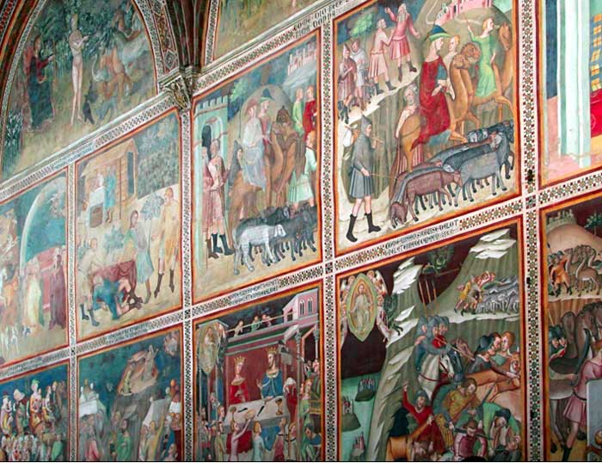
An unforgettable meal
John 12:1-11
Dinner party
Background buzz (John 11:55-57)
Rising tension (Mark 14:1-2)
The meal itself (12:1-2)
Mary’s action (12:3)
Different reactions (12:4-8)
The outcome (12:9-11)
Practical lessons
God loves extravagant expressions of devotion
Attention! Danger !
St. Gimignano

Slide 15
An unforgettable meal
John 12:1-11
Dinner party
Background buzz (John 11:55-57)
Rising tension (Mark 14:1-2)
The meal itself (12:1-2)
Mary’s action (12:3)
Different reactions (12:4-8)
The outcome (12:9-11)
Practical lessons
God loves extravagant expressions of devotion
Seize every effort to manifest devotion

Slide 16
An unforgettable meal
John 12:1-11
Dinner party
Background buzz (John 11:55-57)
Rising tension (Mark 14:1-2)
The meal itself (12:1-2)
Mary’s action (12:3)
Different reactions (12:4-8)
The outcome (12:9-11)
Practical lessons
God loves extravagant expressions of devotion
Seize every effort to manifest devotion
Efforts like those are not forgotten

Slide 17
An unforgettable meal
John 12:1-11
Dinner party
Background buzz (John 11:55-57)
Rising tension (Mark 14:1-2)
The meal itself (12:1-2)
Mary’s action (12:3)
Different reactions (12:4-8)
The outcome (12:9-11)
Practical lessons
God loves extravagant expressions of devotion
Seize every effort to manifest devotion
Efforts like those are not forgotten
“He is no fool who gives up what he cannot keep to gain what he cannot lose.” J. Elliott

Slide 18
An unforgettable meal
John 12:1-11
Dinner party
Background buzz (John 11:55-57)
Rising tension (Mark 14:1-2)
The meal itself (12:1-2)
Mary’s action (12:3)
Different reactions (12:4-8)
The outcome (12:9-11)
Practical lessons
God loves extravagant expressions of devotion
Seize every effort to manifest devotion
Efforts like those are not forgotten
Serve the Lord and the poor

Slide 19
An unforgettable meal
John 12:1-11
Dinner party
Background buzz (John 11:55-57)
Rising tension (Mark 14:1-2)
The meal itself (12:1-2)
Mary’s action (12:3)
Different reactions (12:4-8)
The outcome (12:9-11)
Practical lessons
“If there is a poor man among your brothers in any of the towns of the land that the Lord your God is giving you, do not be hard-hearted or tight-fisted towards your poor brother. Rather be open-handed and freely lend whatever he needs...Give generously to him and do so without a grudging heart; then, because of this, the Lord will bless you… There will always be poor people in the land. Therefore I command you to be open-handed towards your brothers and towards the poor and needy in the land” (Deut. 15:7-11).
God loves extravagant expressions of devotion
Seize every effort to manifest devotion
Efforts like those are not forgotten
Serve the Lord and the poor

Slide 20
An unforgettable meal
John 12:1-11
Dinner party
Background buzz (John 11:55-57)
Rising tension (Mark 14:1-2)
The meal itself (12:1-2)
Mary’s action (12:3)
Different reactions (12:4-8)
The outcome (12:9-11)
Practical lessons
With great power the apostles continued to testify to the resurrection of the Lord Jesus, and much grace was with them all. And then we read these astonishing words, “there were NO needy persons among them. For from time to time those who owned land or houses sold them, brought the money from the sales and put it at the apostles’ feet, and it was distributed to anyone who had need. (Acts 4:34-35).
God loves extravagant expressions of devotion
Seize every effort to manifest devotion
Efforts like those are not forgotten
Serve the Lord and the poor

